Slide 1
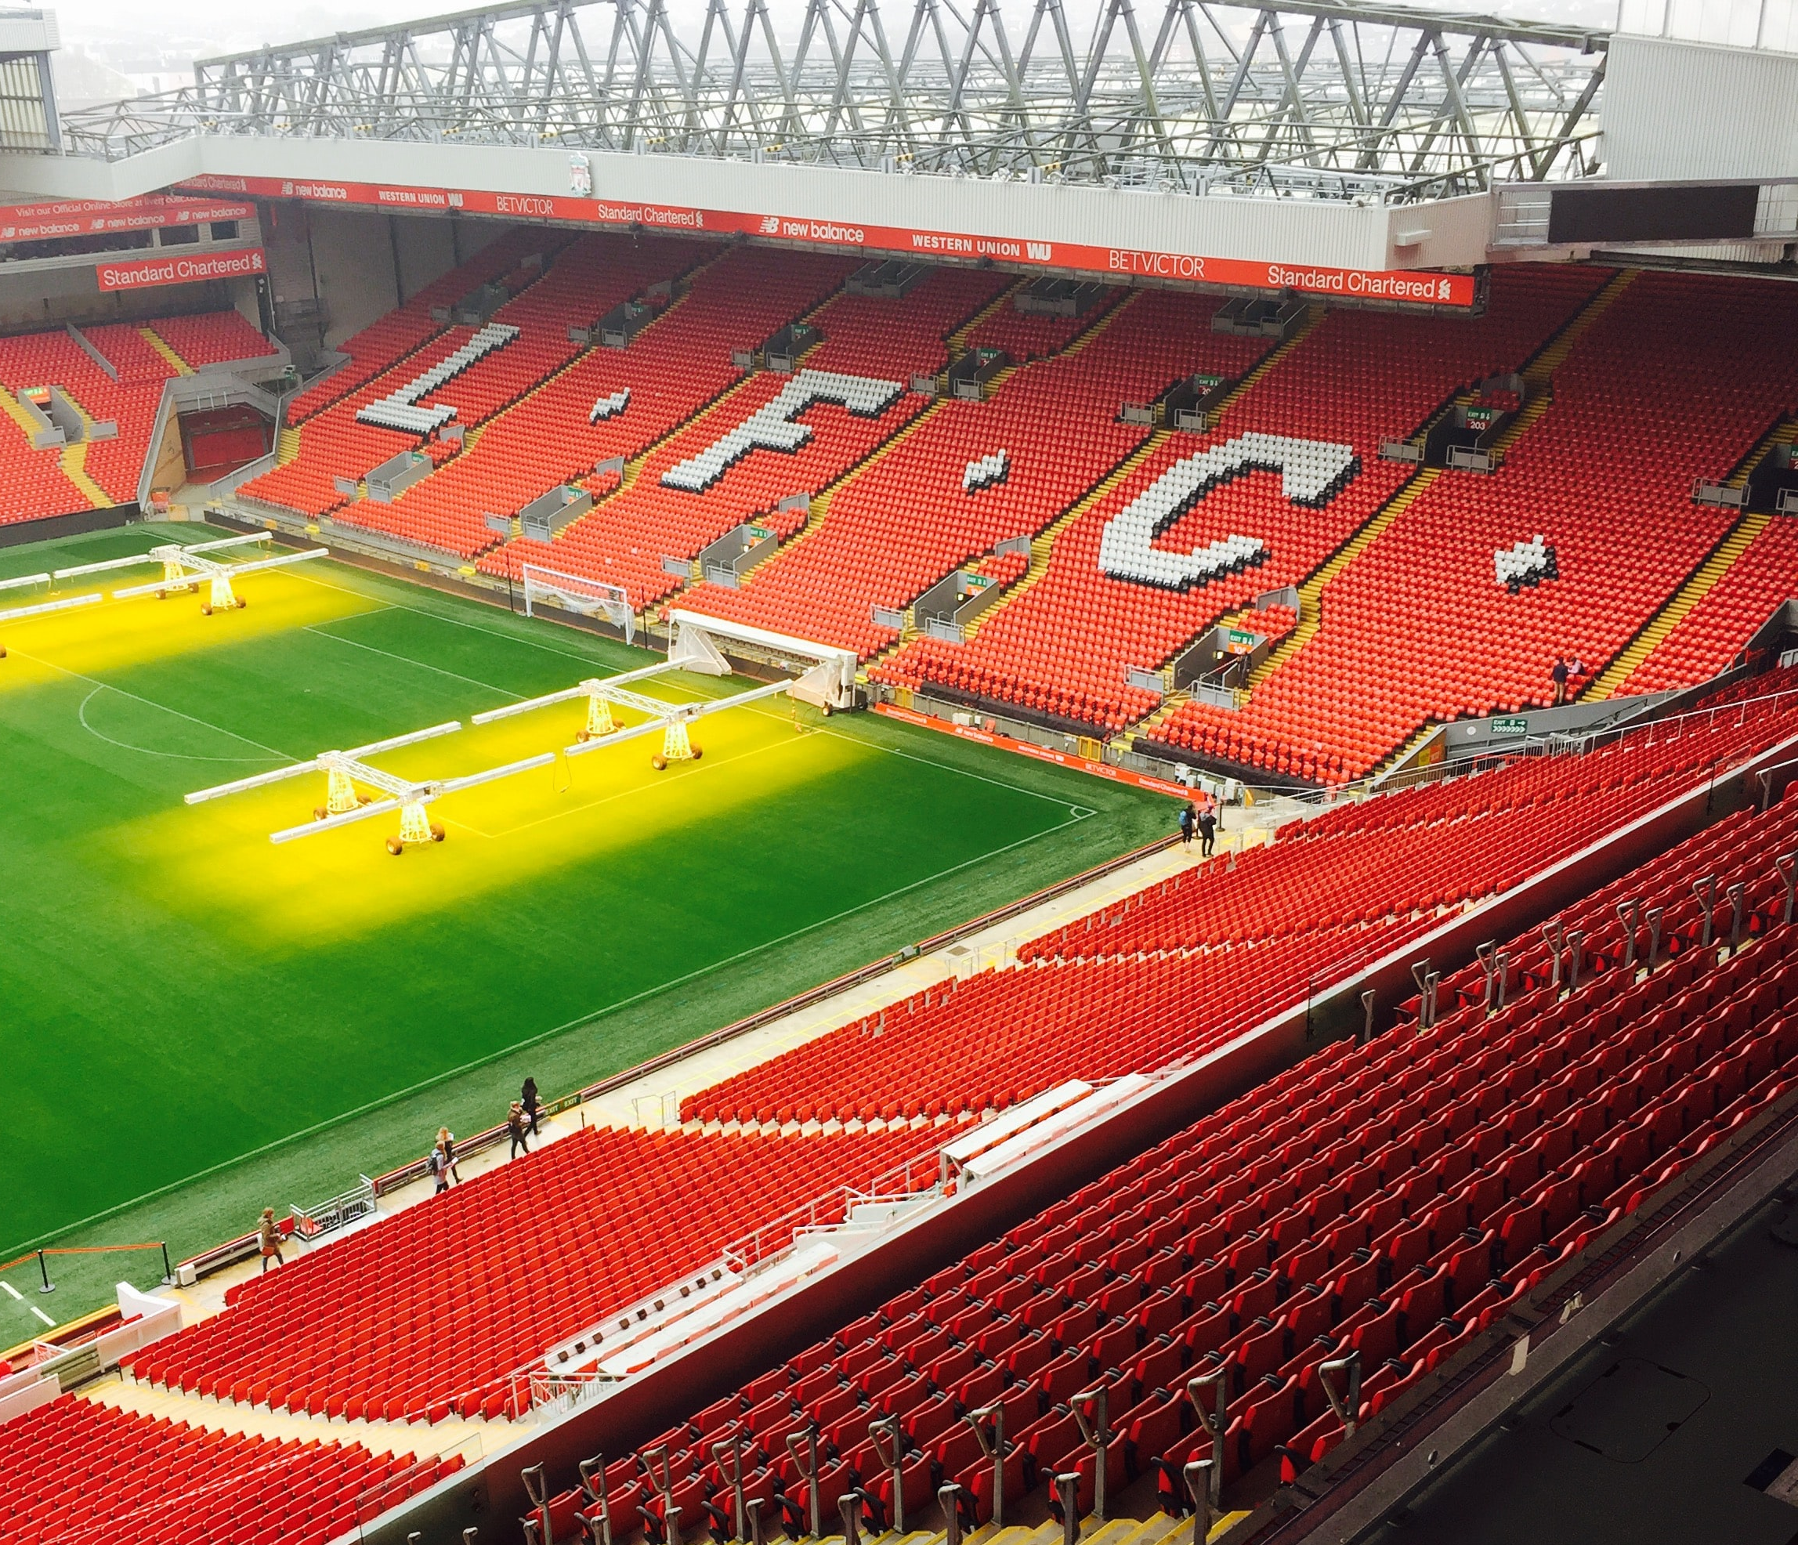

THE TALE OF LIVERPOOL
A comprehensive Look at Liverpool FC through Data
AM10 – Group Project
MAM/Group 8
23rd of November, 2022

Slide 2
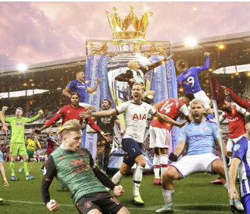






We included several datasets to ensure a thorough analysis
2021-2023 Football Team Stats
2015-2023 FIFA
Player Stats
100 Most Valuable Football Teams
2021-2023 Football Player Stats
1992-2022
Football Transfers

Slide 3
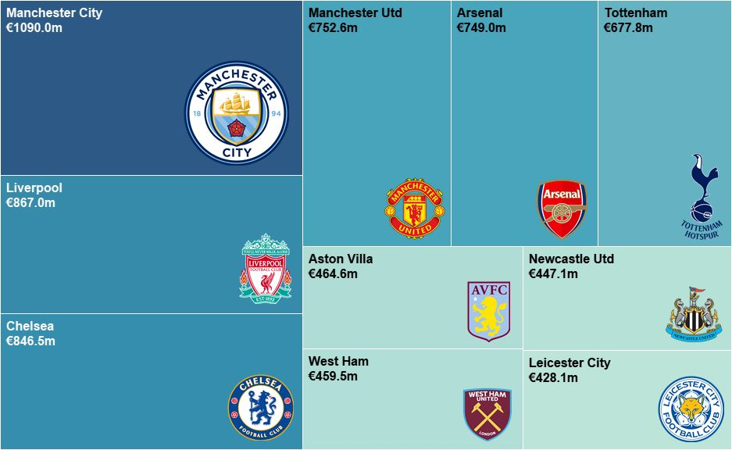
Liverpool is facing intense competition in the Premier League
Liverpool is currently 2nd most valuable team in the Premier League
Treemap of current sum of player value per team

Slide 4
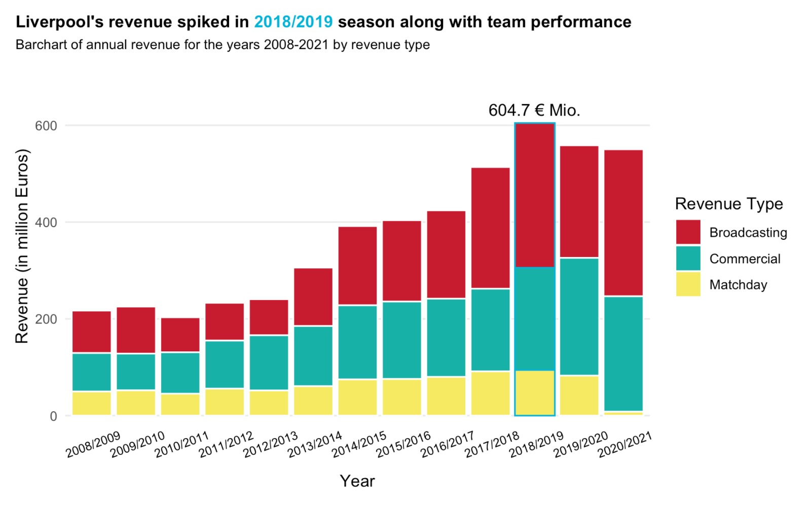
The more revenue a team makes, the better players it can afford

Slide 5
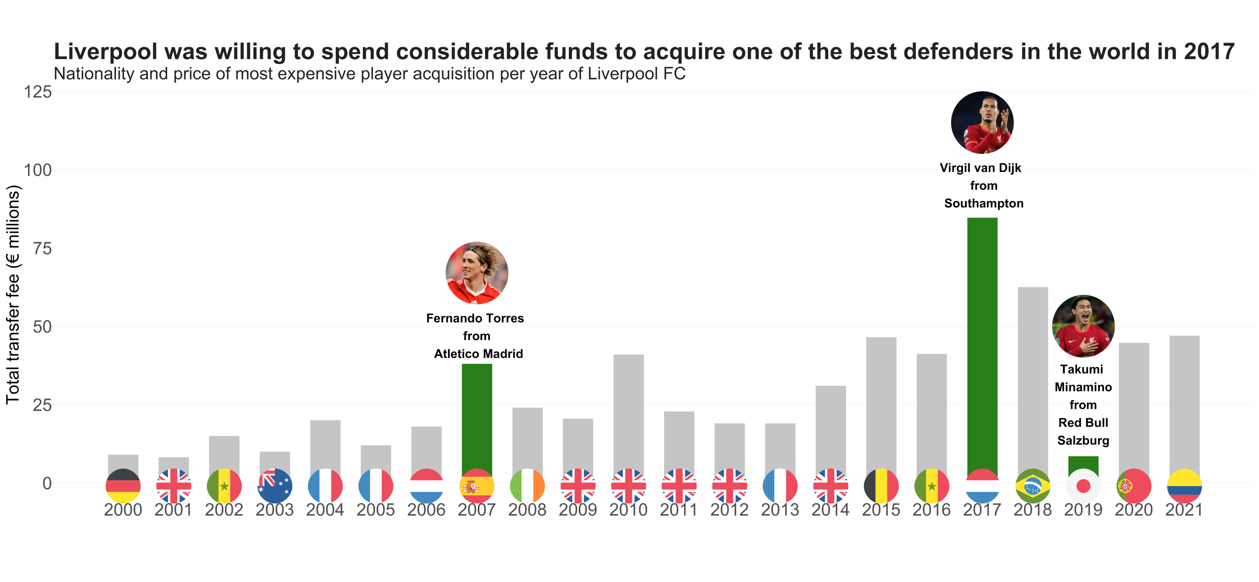
To be competitive in football, purchasing the right talent is crucial

Slide 6
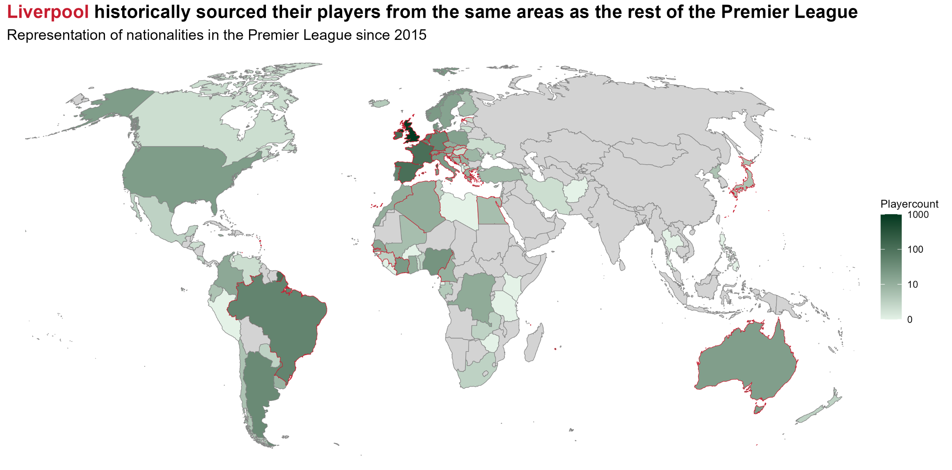
So where do the top players come from?

Slide 7
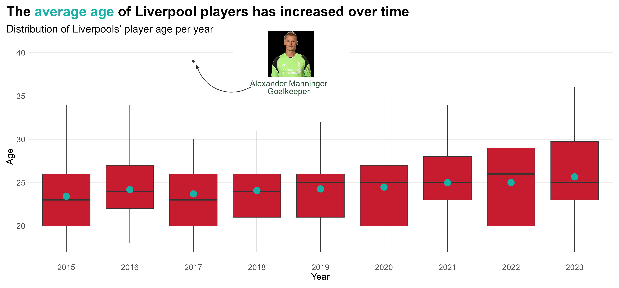
For LFC to stay aggressive, young energetic players are important

Slide 8
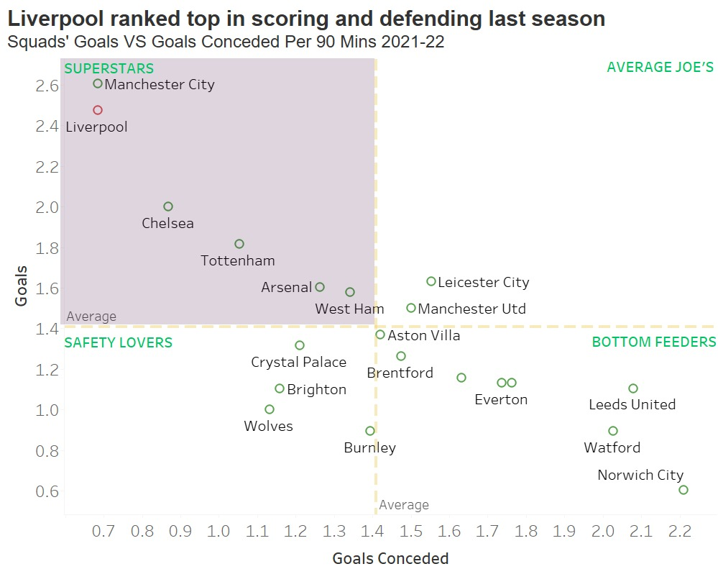
Last season was a great year for Liverpool in the Premier League

Slide 9
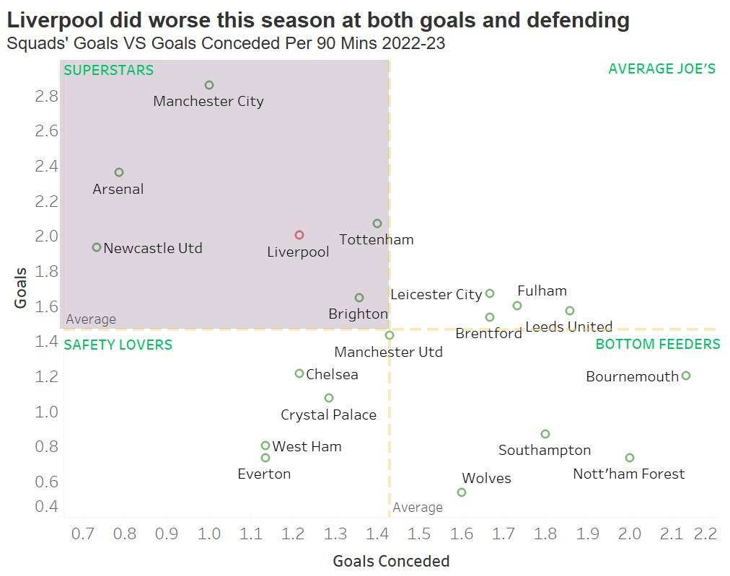
This year we are seeing some unfortunate changes

Slide 10
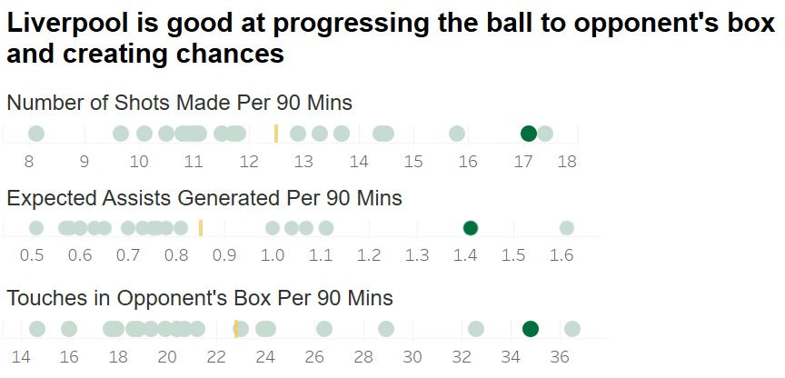
Any top team must be reliably able to generate opportunities

Slide 11
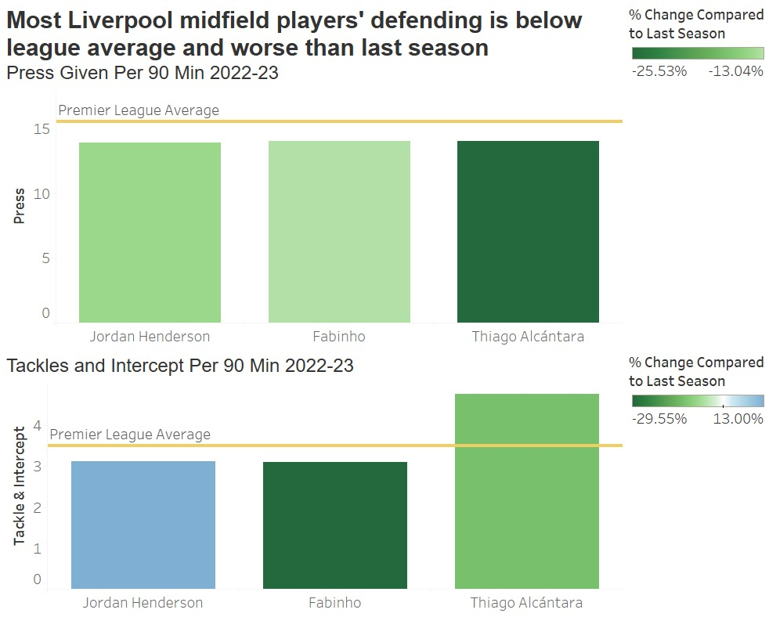
Similar to foosball, the midfield is key in defending attacks

Slide 12
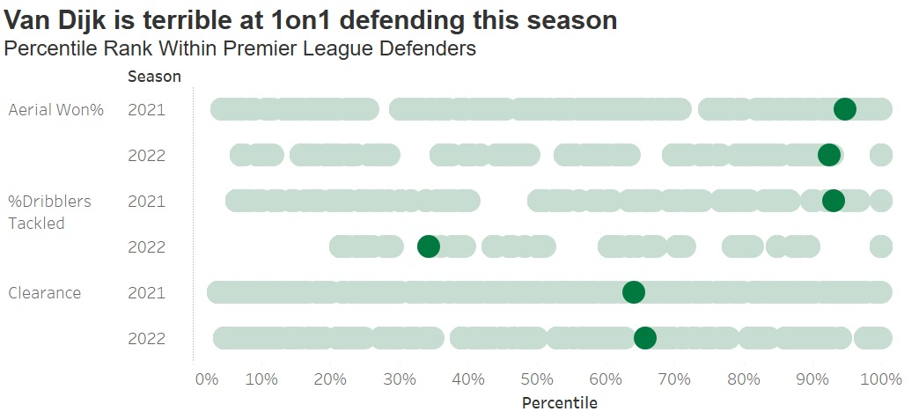

Even individual players not performing can affect the team at large

Slide 13
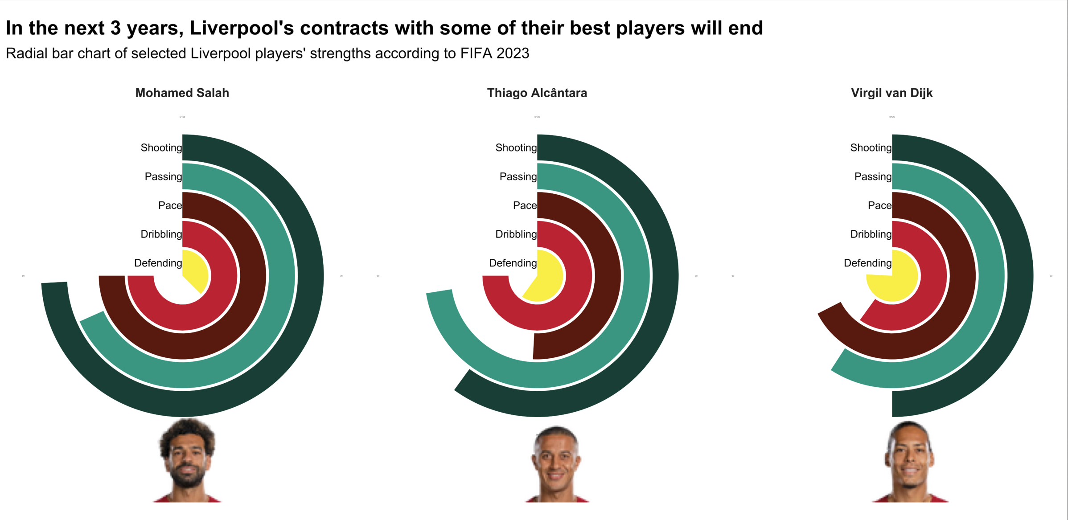
With high-profile contract expiring, competitors will not stand idle
Leaves 2023
Leaves 2024
Leaves 2025

Slide 14
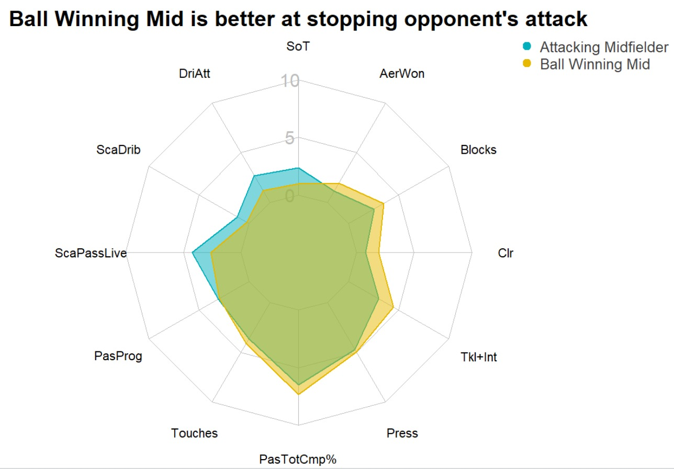
Clustering tells us what positions are most effective at which task

Slide 15
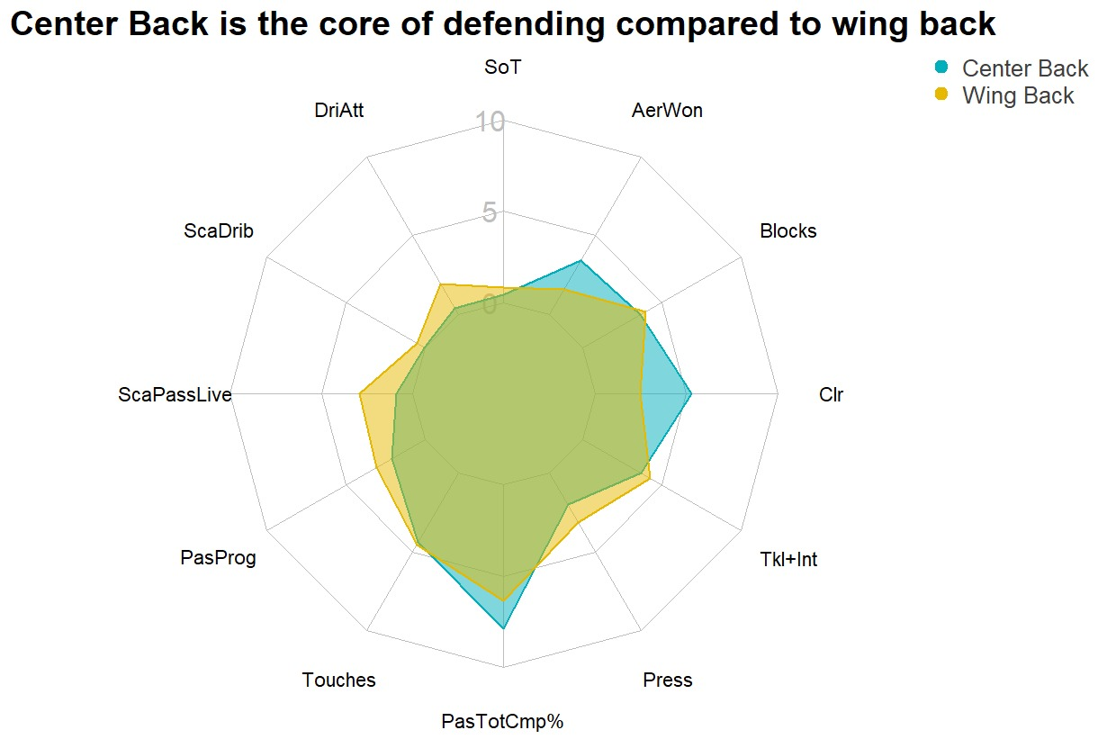
Clustering tells us what positions are most effective at which task

Slide 16
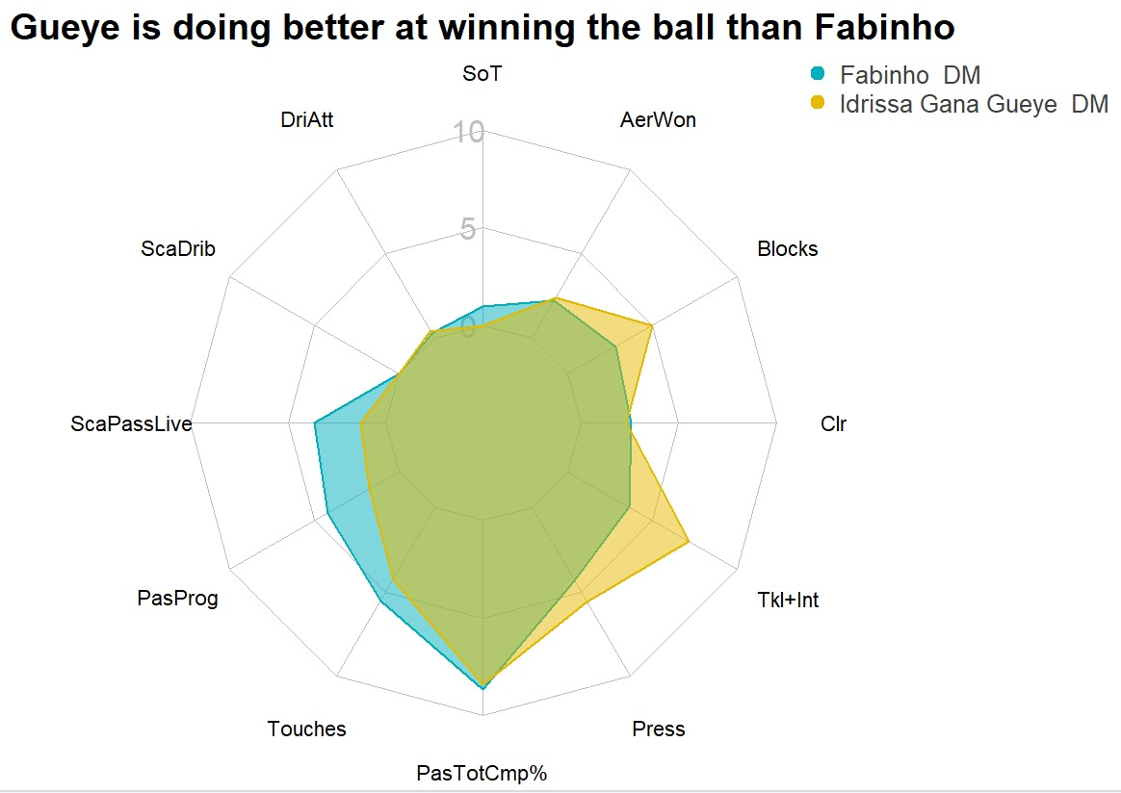
In the Premier League, we highlight potential acquisition targets

Slide 17
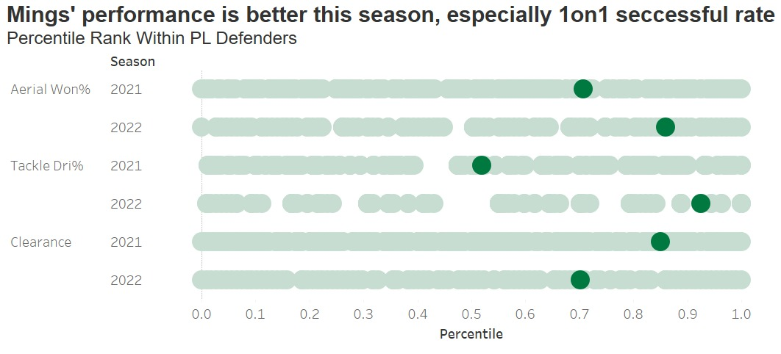

There is also a rather promising defender to consider

Slide 18
THANK
YOU

